Slide 1
Bioinformatic Identification of Transcriptional Regulatory Motifs Responsible for Pollen-Specific Expression of Hydroxyproline-Rich Glycoproteins (HRGPs) in Arabidopsis Thaliana Yichao Li

Slide 2
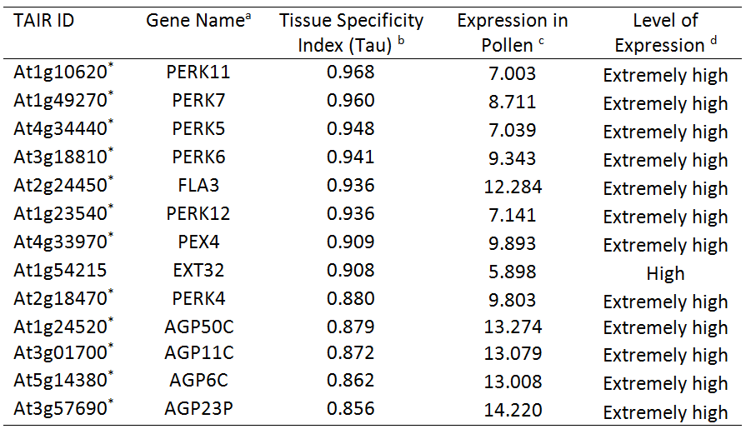
Summary of current result
How many HRGP genes are specifically expressed in pollen?
13 HRGP genes
Obtained by analyzing 33,602 genes’ expression profile (RNA-seq) in 113 samples in 11 tissues
Method: tissue specificity index (Tau)

Slide 3
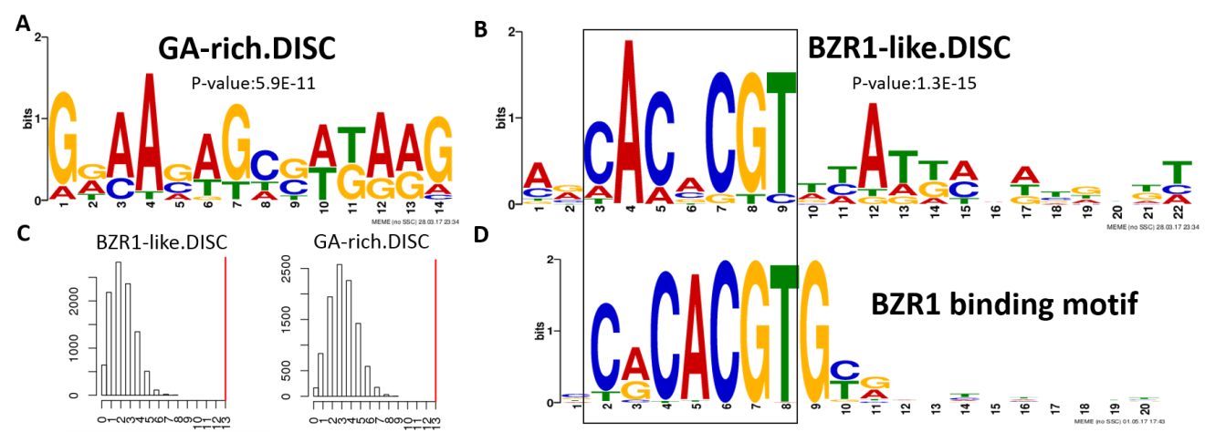
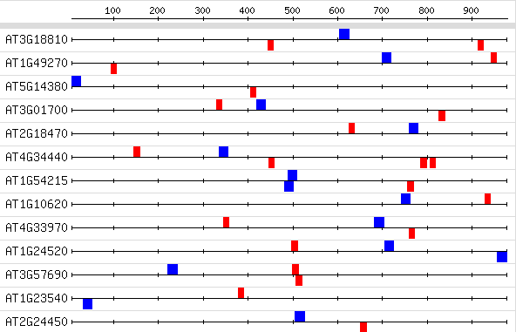
Summary of current result
Why these 13 HRGP genes?
Looking for answers in their promoter regions
Found one module (consists of two motifs) that was unique to the 13 HRGP genes comparing to 132 non-pollen HRGP genes.

Slide 4
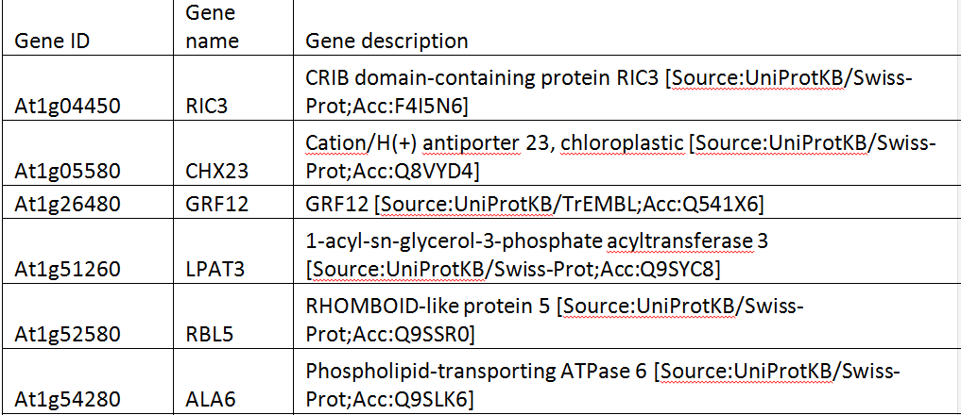
Summary of current result
What other pollen-specific genes are co-regulated by this module?
Looking for answers in their promoter regions
41 putative co-regulated genes were found

Slide 5
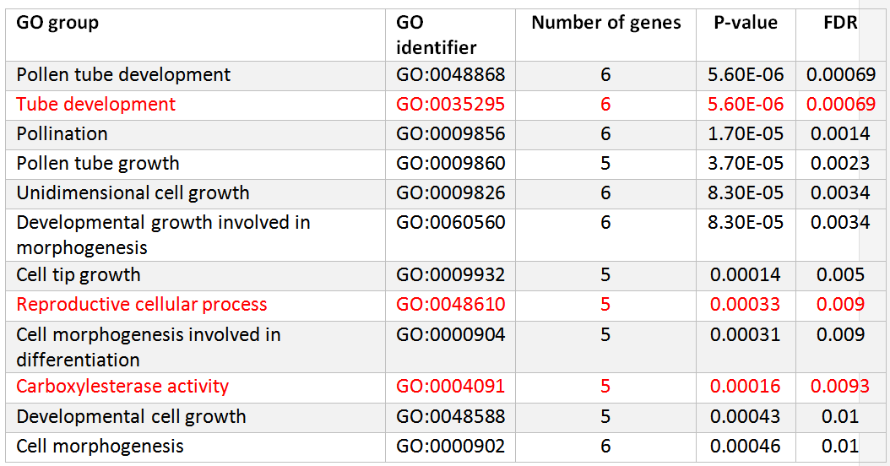
Summary of current result
What biological functions do the co-regulated genes have?
Looking for answers in gene annotation databases
12 statistically significant functions were found

Slide 6
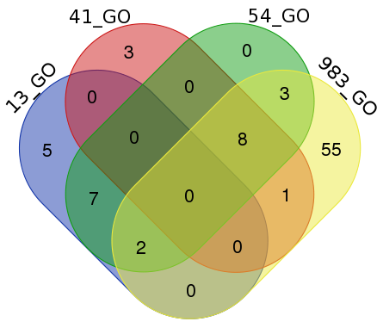
Super-set

Slide 7
GO result for 13 pollen-specific HRGP genes

Slide 8
GO result for 983 pollen-specific genes
GO:0044703 | multi-organism reproductive process | 74 | 368 | 4.1e-34 | 1e-30
GO:0009860 | pollen tube growth | 44 | 138 | 1.5e-27 | 7.3e-25
GO:0009856 | pollination | 57 | 268 | 1.5e-27 | 7.3e-25
GO:0048868 | pollen tube development | 50 | 191 | 8.1e-28 | 7.3e-25
GO:0044706 | multi-multicellular organism process | 57 | 268 | 1.5e-27 | 7.3e-25
GO:0009932 | cell tip growth | 44 | 162 | 3.6e-25 | 1.5e-22
GO:0048588 | developmental cell growth | 45 | 192 | 1.8e-23 | 6.3e-21
GO:0000904 | cell morphogenesis involved in differentiation | 44 | 226 | 3.1e-20 | 9.5e-18
GO:0009826 | unidimensional cell growth | 47 | 296 | 2.3e-18 | 6.2e-16
GO:0048468 | cell development | 46 | 306 | 3.4e-17 | 7.7e-15
GO:0060560 | developmental growth involved in morphogenesis | 48 | 334 | 3.4e-17 | 7.7e-15
GO:0016049 | cell growth | 50 | 428 | 1.3e-14 | 2.7e-12
GO:0080092 | regulation of pollen tube growth | 16 | 25 | 1.6e-14 | 3e-12
GO:0000902 | cell morphogenesis | 48 | 402 | 2.2e-14 | 3.8e-12
GO:0048235 | pollen sperm cell differentiation | 17 | 34 | 5.1e-14 | 8.5e-12
GO:0060284 | regulation of cell development | 16 | 28 | 5.9e-14 | 8.6e-12
GO:0010769 | regulation of cell morphogenesis involved in differentiation | 16 | 28 | 5.9e-14 | 8.6e-12
GO:0032989 | cellular component morphogenesis | 49 | 436 | 9.2e-14 | 1.3e-11
GO:0022412 | cellular process involved in reproduction in multicellular organism | 17 | 41 | 5.7e-13 | 7.4e-11
GO:0048589 | developmental growth | 48 | 458 | 1.7e-12 | 2.1e-10
GO:0048232 | male gamete generation | 17 | 45 | 1.9e-12 | 2.2e-10
GO:0030154 | cell differentiation | 64 | 768 | 4.4e-12 | 4.9e-10
GO:0055046 | microgametogenesis | 17 | 52 | 1.3e-11 | 1.4e-09
GO:0007276 | gamete generation | 17 | 53 | 1.6e-11 | 1.7e-09
GO:0051510 | regulation of unidimensional cell growth | 16 | 45 | 1.8e-11 | 1.8e-09
GO:0019953 | sexual reproduction | 22 | 118 | 1.7e-10 | 1.6e-08
GO:0045595 | regulation of cell differentiation | 16 | 58 | 4.2e-10 | 3.8e-08
GO:0048869 | cellular developmental process | 70 | 1001 | 6.3e-10 | 5.5e-08
GO:0022604 | regulation of cell morphogenesis | 17 | 78 | 2.6e-09 | 2.3e-07
GO:0006885 | regulation of pH | 14 | 51 | 5.4e-09 | 4.5e-07
GO:0040007 | growth | 52 | 678 | 6.6e-09 | 5.3e-07
GO:0045490 | pectin catabolic process | 18 | 96 | 7.2e-09 | 5.6e-07
GO:0001558 | regulation of cell growth | 16 | 75 | 1e-08 | 7.5e-07
GO:0009555 | pollen development | 32 | 311 | 1.3e-08 | 9.5e-07
GO:0000272 | polysaccharide catabolic process | 22 | 167 | 5.2e-08 | 3.7e-06
GO:0051704 | multi-organism process | 91 | 1631 | 6.4e-08 | 4.4e-06
GO:0055067 | monovalent inorganic cation homeostasis | 14 | 68 | 1.2e-07 | 8.2e-06
GO:0043900 | regulation of multi-organism process | 17 | 111 | 2.5e-07 | 1.7e-05
GO:0045488 | pectin metabolic process | 19 | 147 | 5.4e-07 | 3.4e-05
GO:0010393 | galacturonan metabolic process | 19 | 148 | 5.9e-07 | 3.7e-05
GO:0006813 | potassium ion transport | 15 | 95 | 9.1e-07 | 5.5e-05
GO:0048229 | gametophyte development | 34 | 422 | 1e-06 | 5.9e-05
GO:0009846 | pollen germination | 12 | 59 | 1.1e-06 | 6.3e-05
GO:0016052 | carbohydrate catabolic process | 25 | 257 | 1.3e-06 | 7.2e-05
GO:0022603 | regulation of anatomical structure morphogenesis | 17 | 129 | 1.7e-06 | 9.2e-05
GO:0006468 | protein phosphorylation | 57 | 936 | 1.8e-06 | 9.6e-05
GO:0055080 | cation homeostasis | 21 | 194 | 1.9e-06 | 0.0001
GO:0009653 | anatomical structure morphogenesis | 56 | 919 | 2.2e-06 | 0.00011
GO:0048268 | clathrin coat assembly | 7 | 15 | 2.3e-06 | 0.00011
GO:0098771 | inorganic ion homeostasis | 22 | 215 | 2.6e-06 | 0.00013
GO:0045229 | external encapsulating structure organization | 39 | 551 | 3.2e-06 | 0.00016
GO:0048609 | multicellular organismal reproductive process | 18 | 153 | 3.6e-06 | 0.00017
GO:0048638 | regulation of developmental growth | 16 | 123 | 3.9e-06 | 0.00018
GO:0071555 | cell wall organization | 37 | 518 | 4.7e-06 | 0.00022
GO:0007267 | cell-cell signaling | 10 | 46 | 5.1e-06 | 0.00023
GO:0032504 | multicellular organism reproduction | 18 | 160 | 6.3e-06 | 0.00028
GO:0050801 | ion homeostasis | 22 | 229 | 6.6e-06 | 0.00029
GO:0040008 | regulation of growth | 24 | 276 | 1.2e-05 | 0.00051
GO:0016043 | cellular component organization | 112 | 2456 | 2.2e-05 | 0.00093
GO:0007166 | cell surface receptor signaling pathway | 21 | 234 | 2.7e-05 | 0.0011
GO:0043086 | negative regulation of catalytic activity | 13 | 99 | 2.8e-05 | 0.0011
GO:0030001 | metal ion transport | 22 | 263 | 4.7e-05 | 0.0019
GO:0042545 | cell wall modification | 16 | 156 | 5.7e-05 | 0.0022
GO:0044092 | negative regulation of molecular function | 13 | 112 | 9e-05 | 0.0035
GO:0071554 | cell wall organization or biogenesis | 41 | 704 | 0.00013 | 0.0048
GO:0051128 | regulation of cellular component organization | 22 | 286 | 0.00015 | 0.0055
GO:0018105 | peptidyl-serine phosphorylation | 10 | 76 | 0.00023 | 0.0085
GO:0044702 | single organism reproductive process | 73 | 1544 | 0.00024 | 0.0088
GO:0018209 | peptidyl-serine modification | 10 | 78 | 0.00028 | 0.01

Slide 9
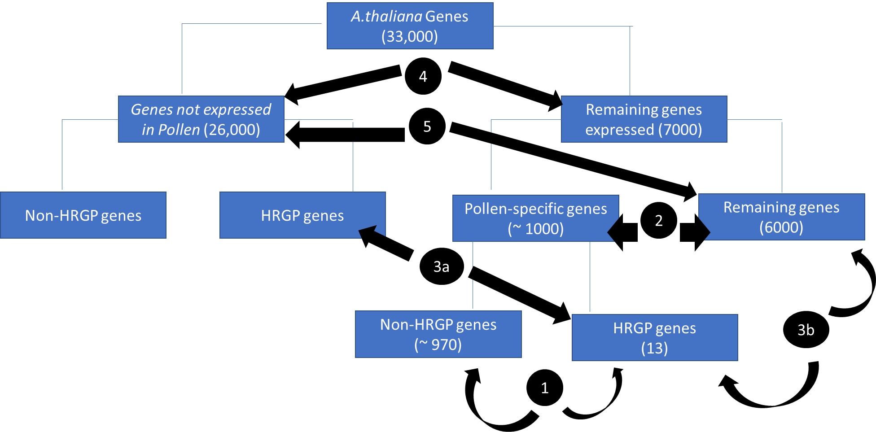
The comparison made last time

Slide 10
More techniques
Feature selection
Association rules

Slide 11
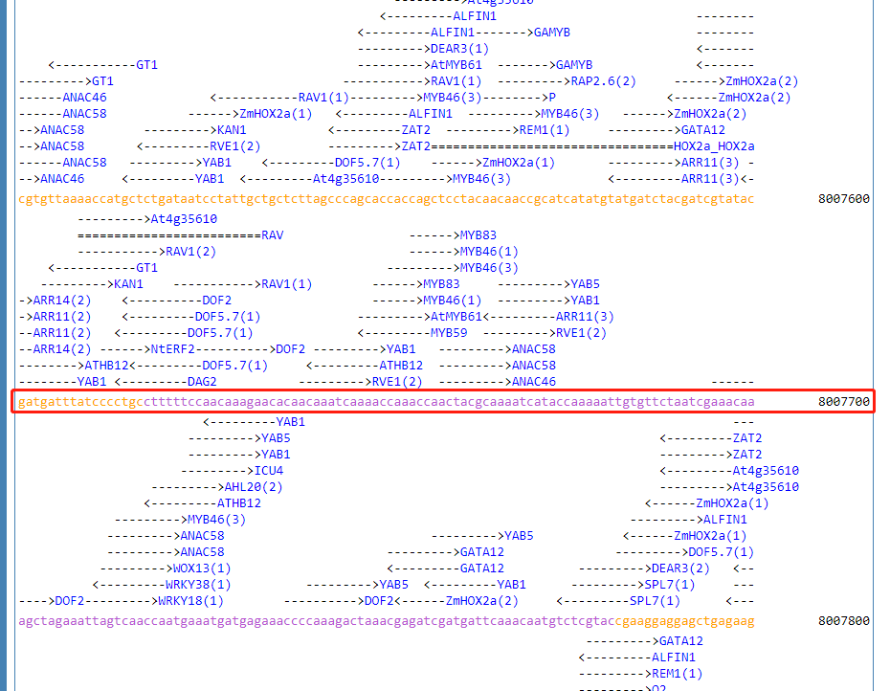
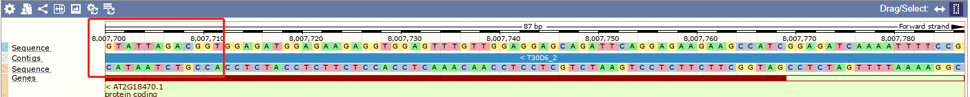
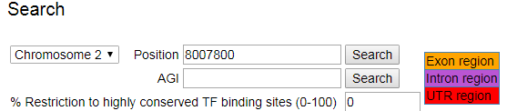

Slide 12
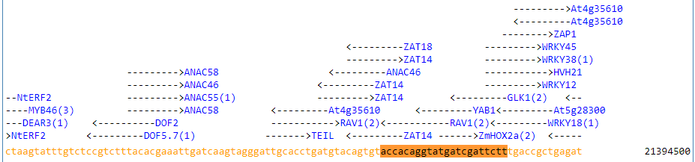
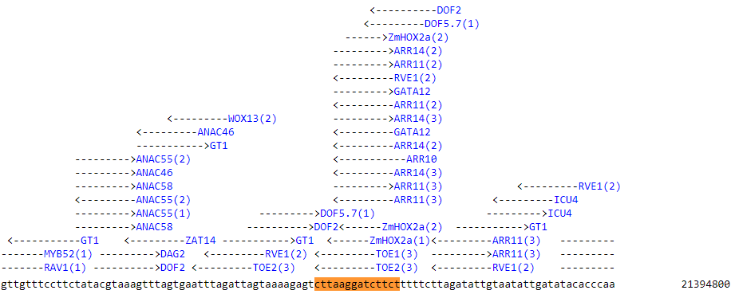
>AT3G57690|AT3G57690.1|AGP23|3|21384146|21384605

Slide 13
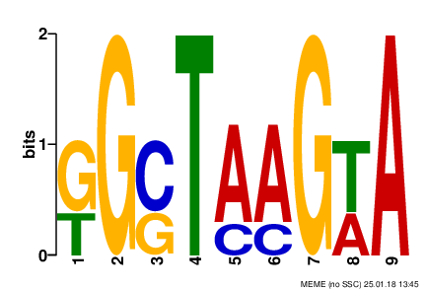
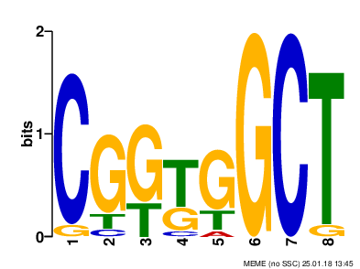
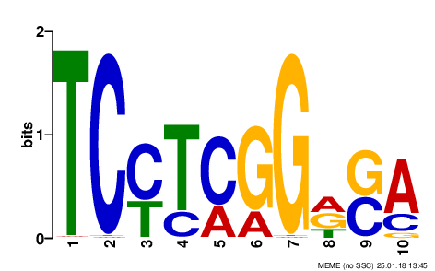
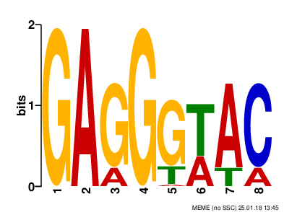
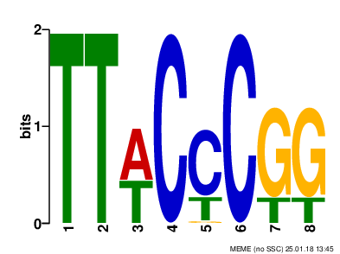
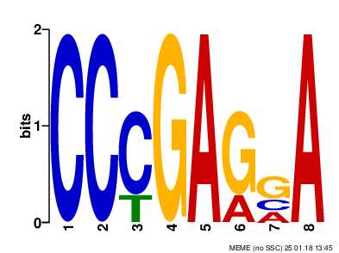
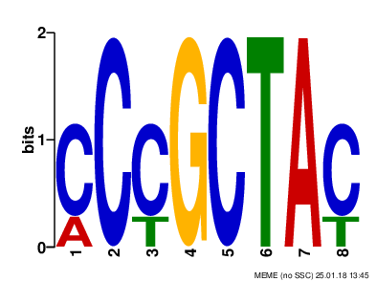
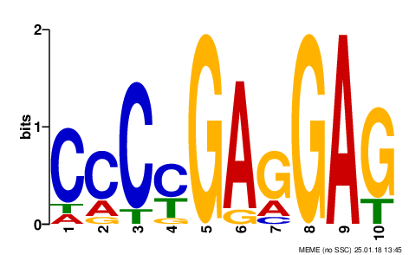
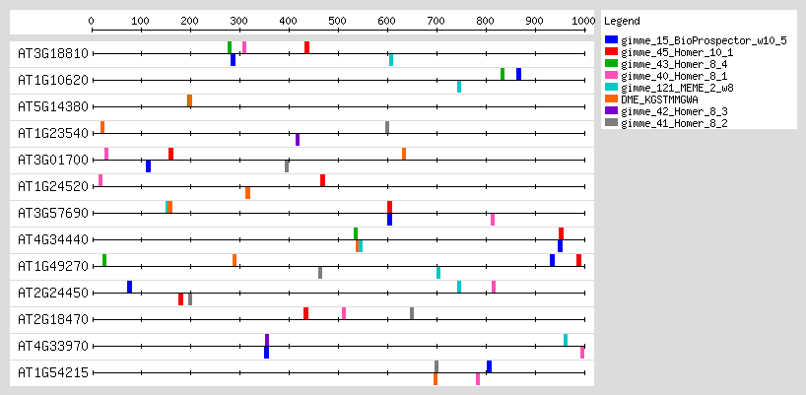
DME_KGSTMMGWA
gimme_121_MEME_2_w8
gimme_15_BioProspector_w10_5
gimme_40_Homer_8_1
gimme_41_Homer_8_2
gimme_42_Homer_8_3
gimme_43_Homer_8_4
gimme_45_Homer_10_1

Slide 14
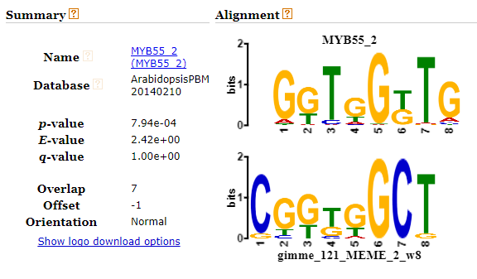
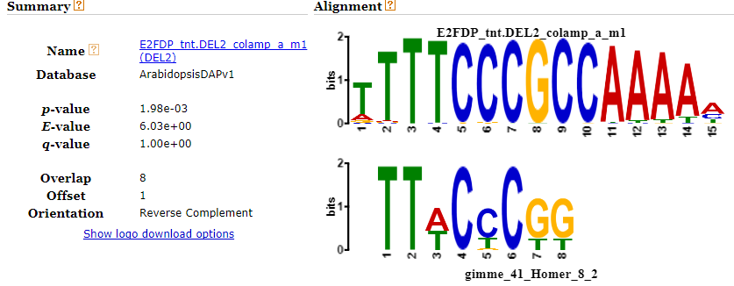
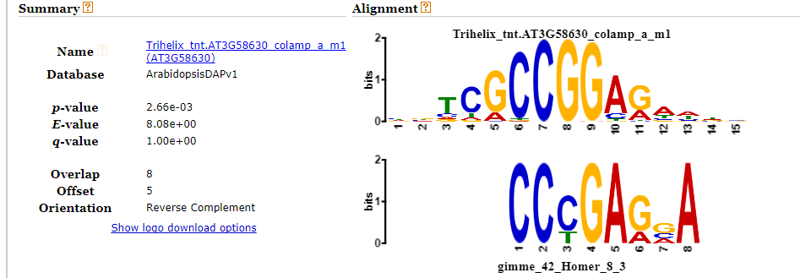
MYB transcription factor genes as regulators for plant responses: an overview: https://www.ncbi.nlm.nih.gov/pmc/articles/PMC3715649/
The E2FD/DEL2 factor is a component of a regulatory network controlling cell proliferation and development in Arabidopsis. https://www.ncbi.nlm.nih.gov/pubmed/19937368

Slide 15
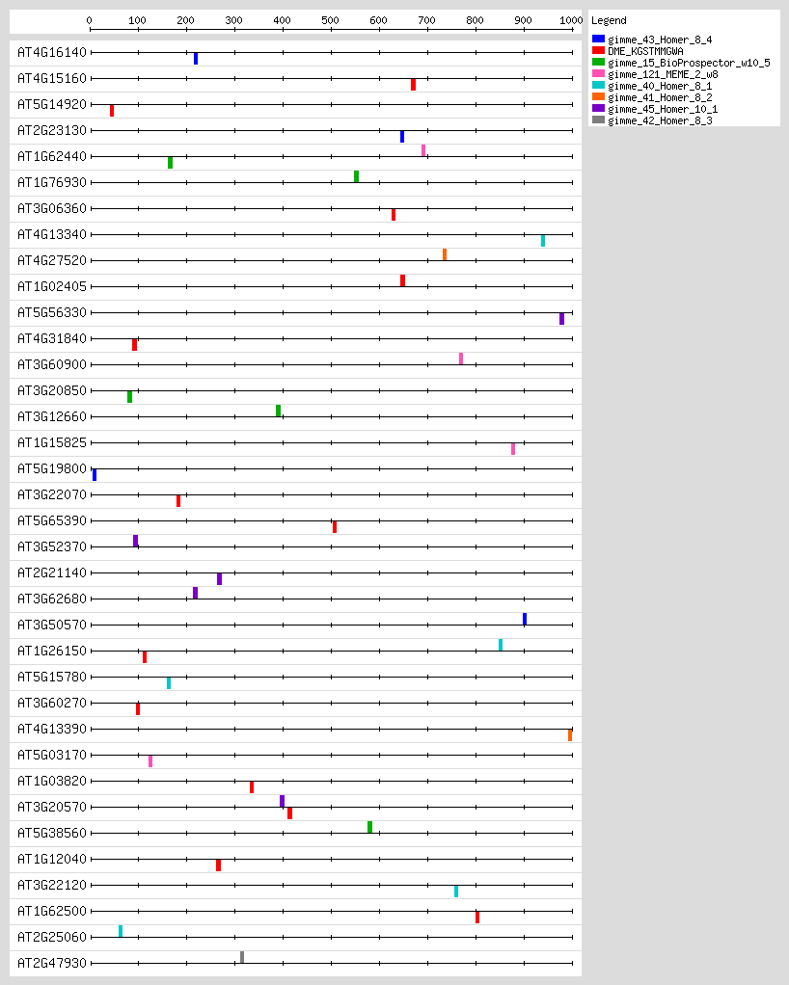

Slide 16






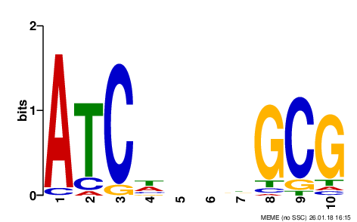
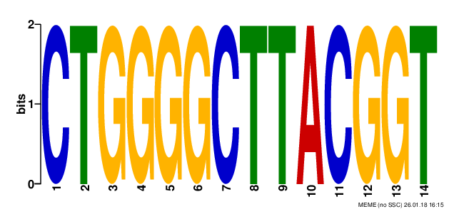
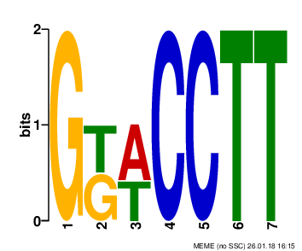
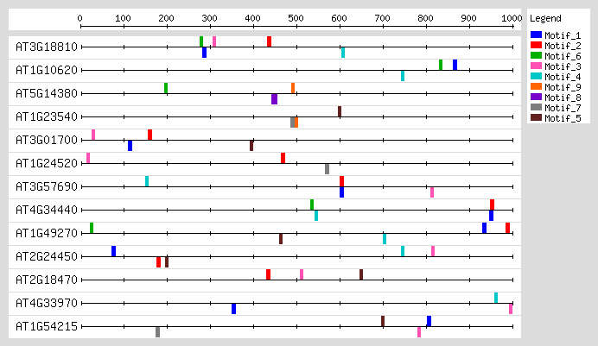
Motif_1
Motif_2
Motif_3
Motif_4
Motif_5
Motif_6
Motif_7
Motif_8
Motif_9

Slide 17
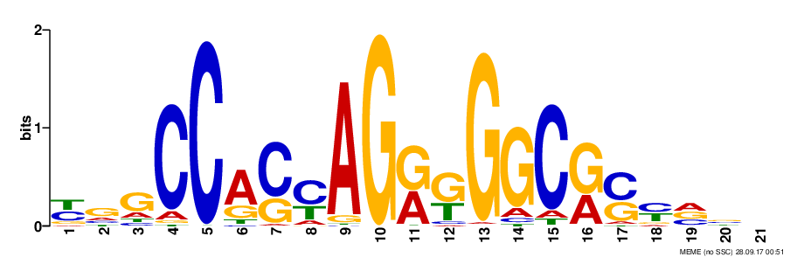
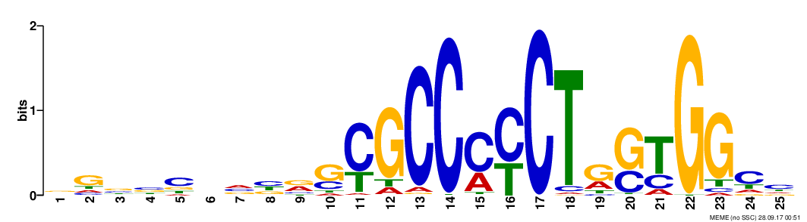
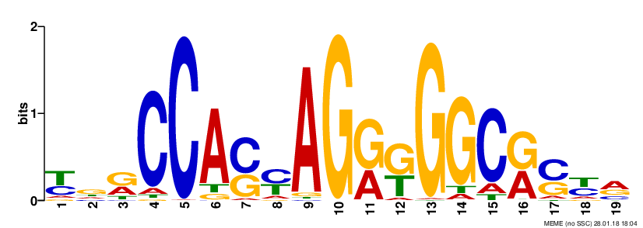
A.
Greedy_PNPSKC Result | K=1
Cost: | 2410
Foreground Coverage: | 84.1%
Background Coverage: | 8.2%
B.
Greedy_SC Result
Cost: | 2412
Foreground Coverage: | 85.5%
Background Coverage: | 9.6%
C.

Slide 18
MotifHyades_chr16_8_p15_e25_10

